Slide 1
IMP Supply Chain Simulation
for Clinical Trials
Monte Carlo Simulation · Sensitivity Analysis · Root-Cause Diagnosis
Cunyi Wang, SDS China
Efficiency+ Supply Chain Working Group | August 2026
Cunyi Wang | J&J Supply Chain | Aug 2026

Slide 2
Background & Context
Why clinical trial drug supply chains are challenging
The Clinical Supply Chain Challenge
Example: a 3-Tier Supply Chain Structure
IMP (Investigational Medicinal Products) have strict shelf-life limits — expired kits are costly waste
🏭 Manufacturing
Batches produced on schedule · 60-day lead time
Patient enrollment is stochastic: timing & rate cannot be predicted precisely
🏪 EU Depot & CN Depot
Threshold-driven replenishment · FEFO expiry management
Multi-tier logistics: Manufacturing → EU/CN Depot → Clinical Sites across 2 regions
🏥 Clinical Sites (EU × 13 + CN × 12)
Patient visits · Kit dispensing · Resupply orders
Stockouts delay patient treatment; over-supply leads to waste and cost
Key tension:
minimize stockout ↔ minimize waste
→ simulation is the only way to quantify this trade-off
Cunyi Wang | J&J Supply Chain | Aug 2026

Slide 3
Project Objectives
Core goals
Drug minimization
01
Initial site stock, resupply
No tolerance for stockout
02
The cost of stockout is high
Costs
03
Shipping costs, packaging costs and other types of costs (stockout, time, etc)
Protection of blind
04
Cunyi Wang | J&J Supply Chain | Aug 2026

Slide 4
Statistical Objectives
Build a Monte Carlo Simulation Engine
01
Develop an IMP supply chain simulation from scratch in R, covering enrollment, visits,
kit dispensing, depot replenishment, expiry management — across EU and CN regions.
Quantify Parameter Sensitivity
02
e.g. Run 400+ simulation replicates across 4 shelf-life scenarios (400/600/720/1000 days)
to measure the impact on stockout rate and waste rate.
Cross-Model Validation
03
Compare two independent simulation models (e.g. SimComb vs 4-Complete) using a unified
KPI definition to identify discrepancies and their root causes.
Improve Reliability & Metric Quality
04
Discover and fix production bugs; redefine flawed KPIs; document all changes so results
are reproducible and trustworthy for supply planning decisions.
Cunyi Wang | J&J Supply Chain | Aug 2026

Slide 5
Clinical Supply Chain Process
Modeling Components Captured in the Specification
# of Regional Patients
100 in EU and 150 in China
Visit Schedule
Weekly (5ml) → Q2W (7.5ml) treatment phases
Lead Time/Shelf Life
Underspecified Rules in the Specification
Patient Enrollment
Gamma-Poisson process; 250 patients across 25 sites
Kit Dispensing
FEFO, blinded kit types (arm A / arm B), paired dispensing
Stock
Initial stock, safety stock, floor/ceiling
Cunyi Wang | J&J Supply Chain | Aug 2026
Notes:
Gamma-Poisson distribution with three level fixed parameters (high, medium, low enrollment rates)

Slide 6
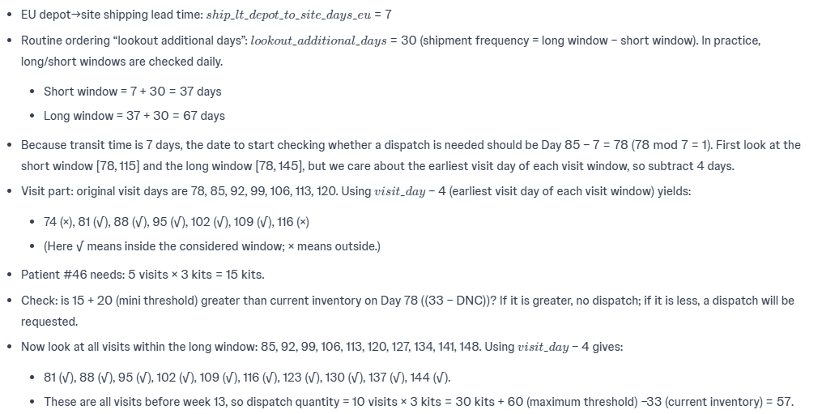
Generate a Simulation Code
Work closely with AI tools, critically reviewing outputs to assess reasonableness and flag potential issues
For example, on day 87, why 57 5ml PBO was sent to EU SITE 6
EU
Cunyi Wang | J&J Supply Chain | Aug 2026

Slide 7
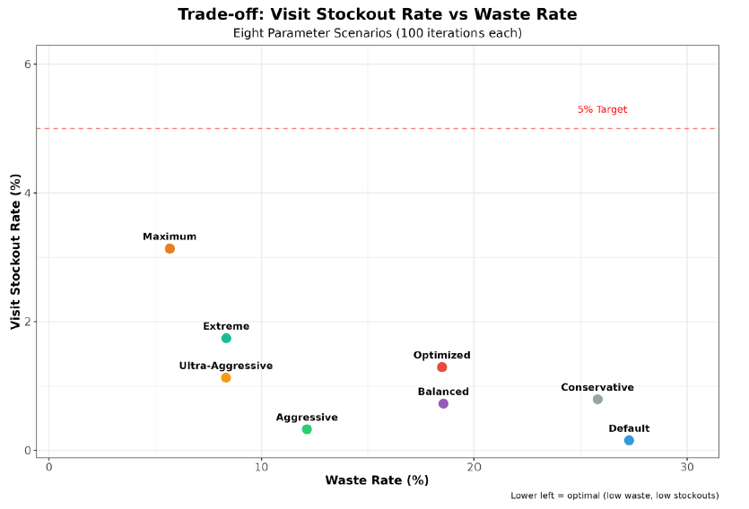
Sensitivity Analysis
EU
Cunyi Wang | J&J Supply Chain | Aug 2026
Notes:
Use the total stockout rate and waste rate to evaluate the simulation performance

Slide 8
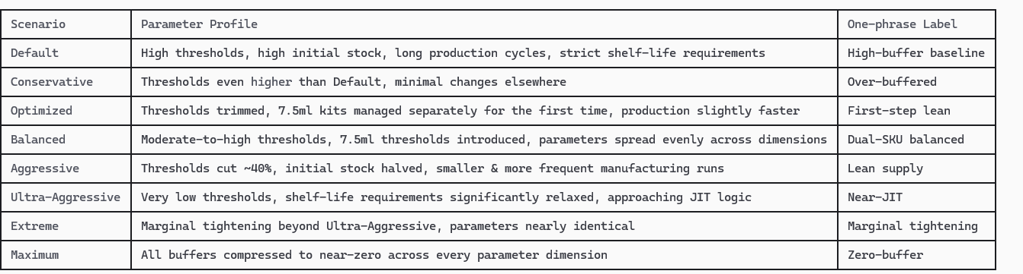
Sensitivity Analysis
EU
Cunyi Wang | J&J Supply Chain | Aug 2026

Slide 9
An Alternative Approach
Old Code
New Code (Kiro skill)
Time consuming (Labor intensive)
Structure complex
Accurate
Efficient (User friendly)
Structure simple
Quality refinement in progress
User specified, trial specified
→
Well-defined, structured input format
Cunyi Wang | J&J Supply Chain | Aug 2026

Slide 10
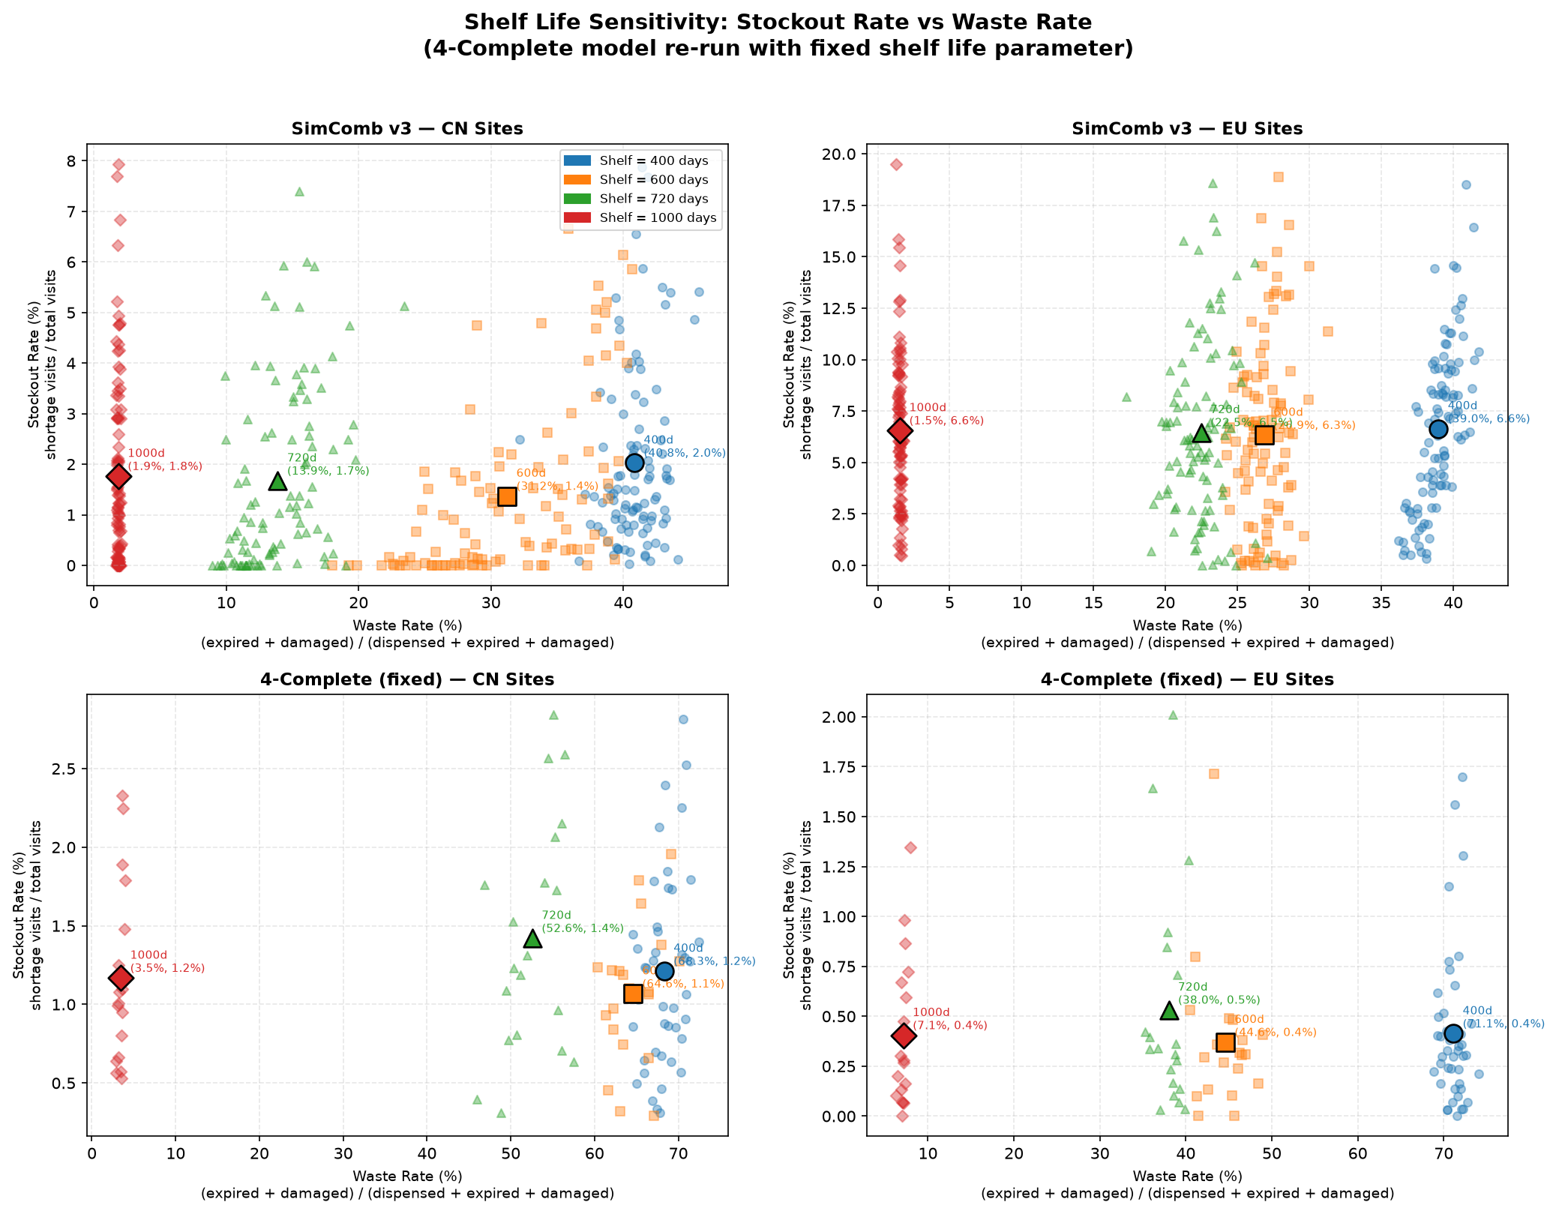
Cross-Model Validation
Input parameters do not match exactly
The logic may differ (underspecified rules in the spec)
Performance metrics – stockout rate, waste rate and definitions
Comparison level – shelf life, manufacturing schedule, safety stock
Cunyi Wang | J&J Supply Chain | Aug 2026
Notes:
Use the total stockout rate and waste rate to evaluate the simulation performance

Slide 11
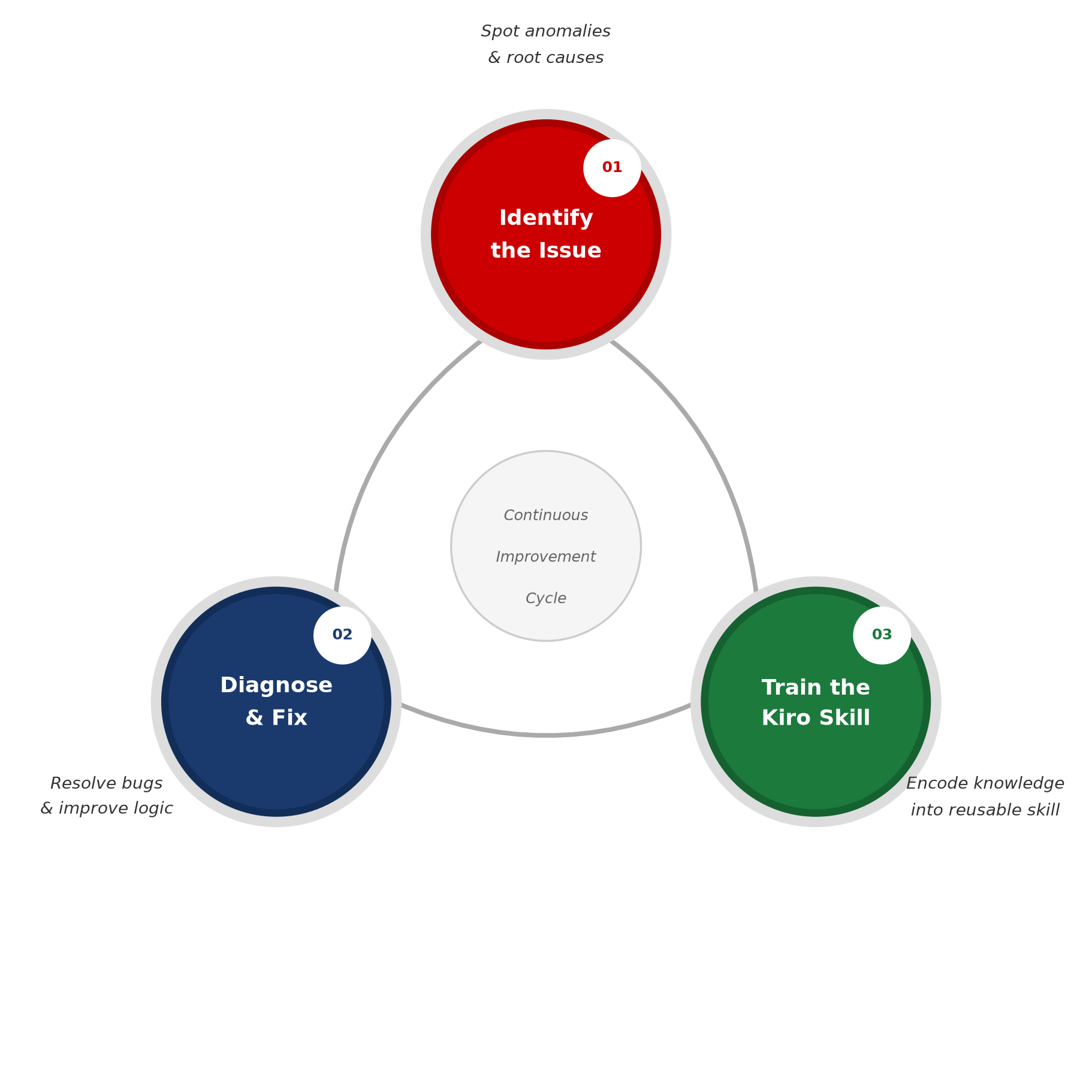
Cross-Model Validation
Input parameters do not match exactly
The logic may differ (underspecified rules in the spec)
Performance metrics – stockout rate, waste rate and definitions
Comparison level – shelf life, manufacturing schedule, safety stock
Cunyi Wang | J&J Supply Chain | Aug 2026
Notes:
Use the total stockout rate and waste rate to evaluate the simulation performance

Slide 12
Constraints
How many languages can be placed on the label (dictates the available pool of kits per depot/country/site).
Number of depots
Time required to clear customs within the country.
Shelf life/expiry/damaged.
Temperature restrictions (cold storage or room temperature)
Expected patients/site (range, high enrollers, median, average)
Central randomization, adaptive, by site
Randomization block size
Treatment allocation ratio
If randomization is stratified, is the allocation ratio/blocksize the same across strata
Time required from notification of resupply to actually getting drug to depot/site
Safety stock level setting overtime
Shipment frequency, which depends on the product types (e.g. small molecule products), the stocking cost, the product cost, demands
Dose levels and titration may not always be well known at the beginning of a trial, particularly in trials when dose is based upon weight, body surface area or a patient lab results
Drug is designated to a particular study/site or available to other studies/sites
Cunyi Wang | J&J Supply Chain | Aug 2026

Slide 13
Spec or Skill
Spec — "What this specific task requires"
Skill— “How to do it and lessons learned"
A spec is a task-level requirements document.
Content:
Trial design, e.g. number of pts, arms, arm ratio
Kit configuration, e.g. kit types, quantity per visit
Supply chain structure, e.g. number of sites, depot hierarchy lead times
Replenishment parameters, e.g. min/max threshold, initial inventory levels, manufacturing batch and interval
Regulatory, e.g. DND window, whether FEFO is mandatory, blinding design
Information that is reusable across trials — patterns and lessons learned
Known bugs & fixes
KPI definitions & calculation methods, e.g. waste rate, stockout rate
Tuning parameters, e.g. temperature, languages
Structural supply risk, e.g. 7.5 ml Q2W is the most vulnerable link, CN depot is most shelf-life sensitive
→
Cunyi Wang | J&J Supply Chain | Aug 2026

Slide 14
Future Work
🔧 Built
A structured template to systematically document all information required for the CSC simulation
📊 Quantified
A production-ready Kiro skill capable of generating accurate results with minimal manual effort
🐛 Discovered & Fixed
A tool designed to verify and validate simulation outputs against predefined rules
📐 Redesigned
A dynamic simulation model
🔍 Others
Cunyi Wang | J&J Supply Chain | Aug 2026

Slide 15
Thank You
Questions & Discussion
Cunyi Wang | J&J Supply Chain | August 2026
Cunyi Wang | J&J Supply Chain | Aug 2026

Slide 16
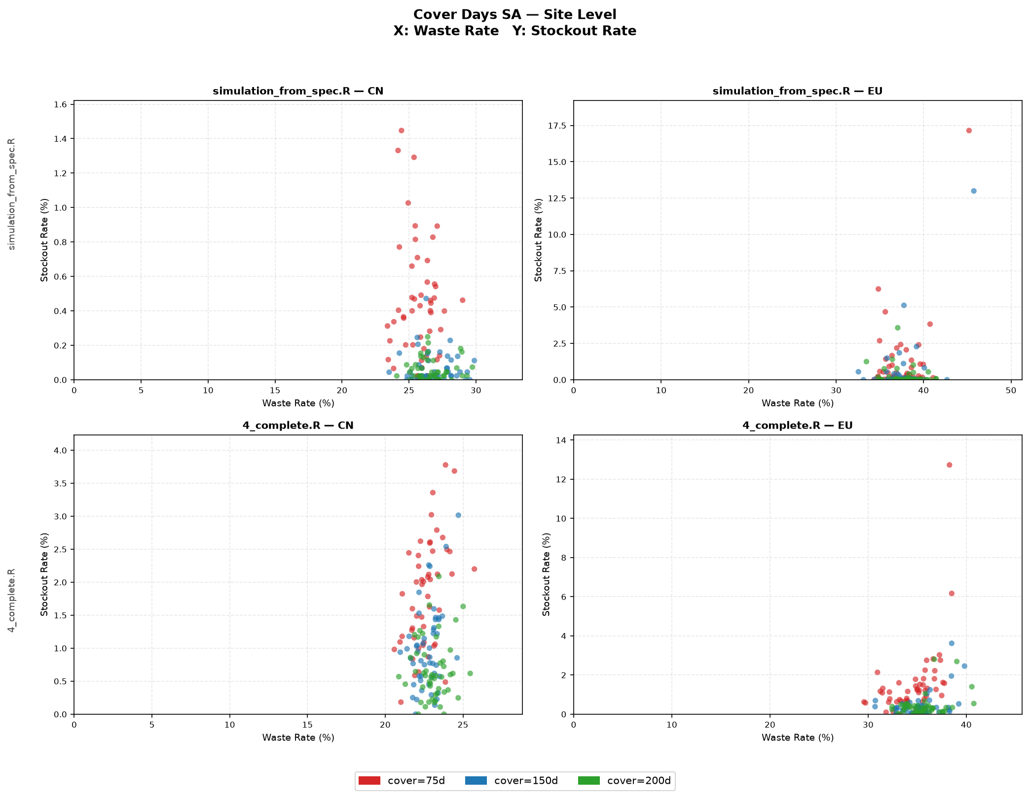
Cross model validation – cover (site level)
Shelf life =720
mfg_cycle_cover_days=75, 150, 200
Cunyi Wang | J&J Supply Chain | Aug 2026

Slide 17
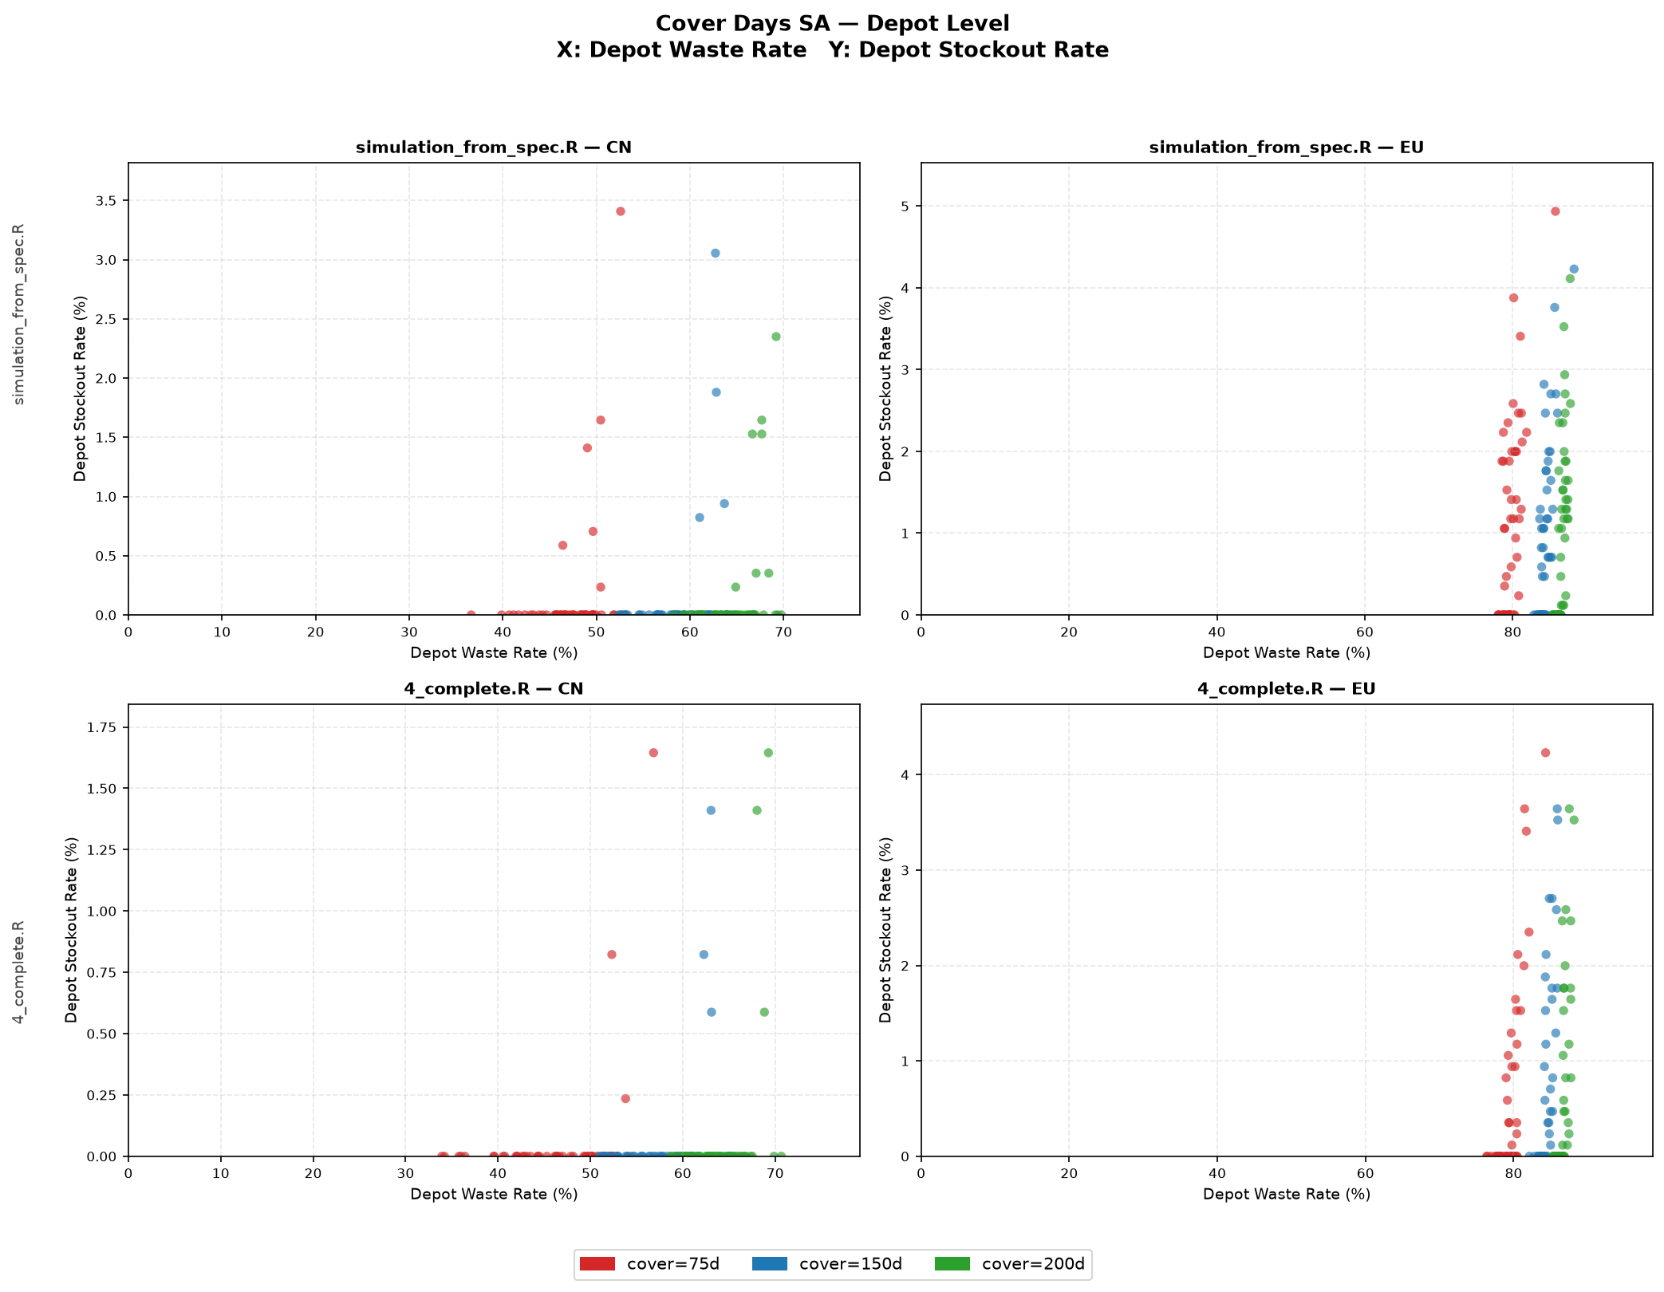
Cross model validation – cover (depot level)
Shelf life =720
mfg_cycle_cover_days=75, 150, 200
Cunyi Wang | J&J Supply Chain | Aug 2026

Slide 18
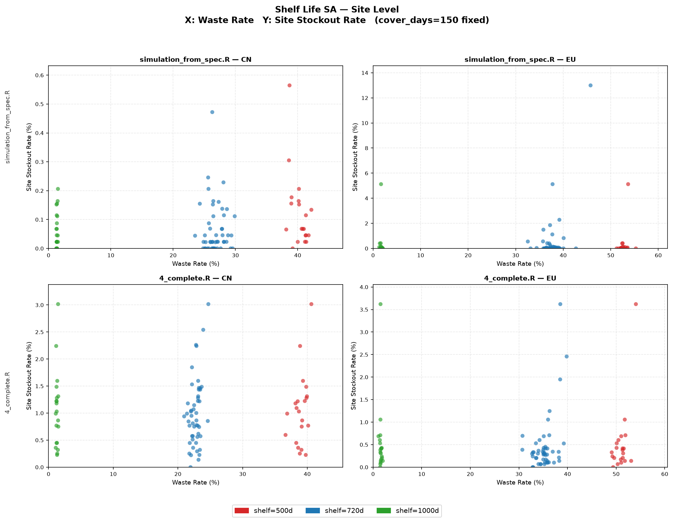
Cross model validation – cover (site level)
mfg_cycle_cover_days=150
Shelf life =500, 720, 1000
Cunyi Wang | J&J Supply Chain | Aug 2026

Slide 19
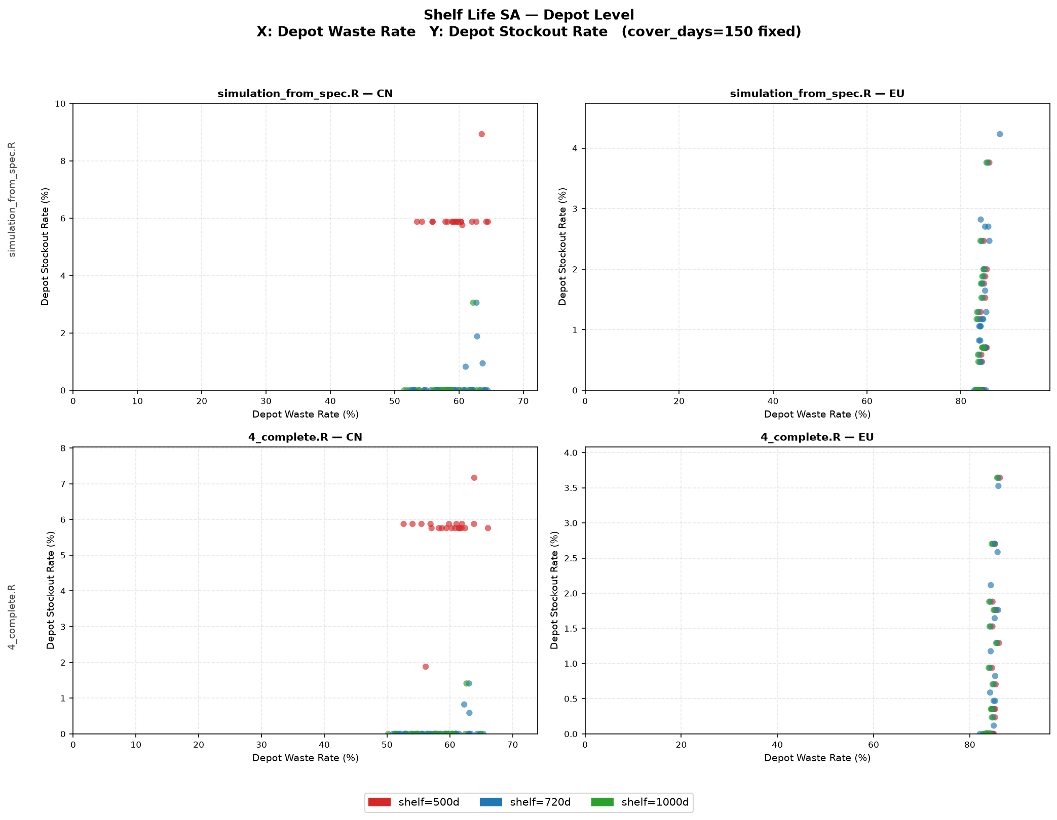
Cross model validation – cover (depot level)
mfg_cycle_cover_days=150
Shelf life =500, 720, 1000
Cunyi Wang | J&J Supply Chain | Aug 2026

Slide 20
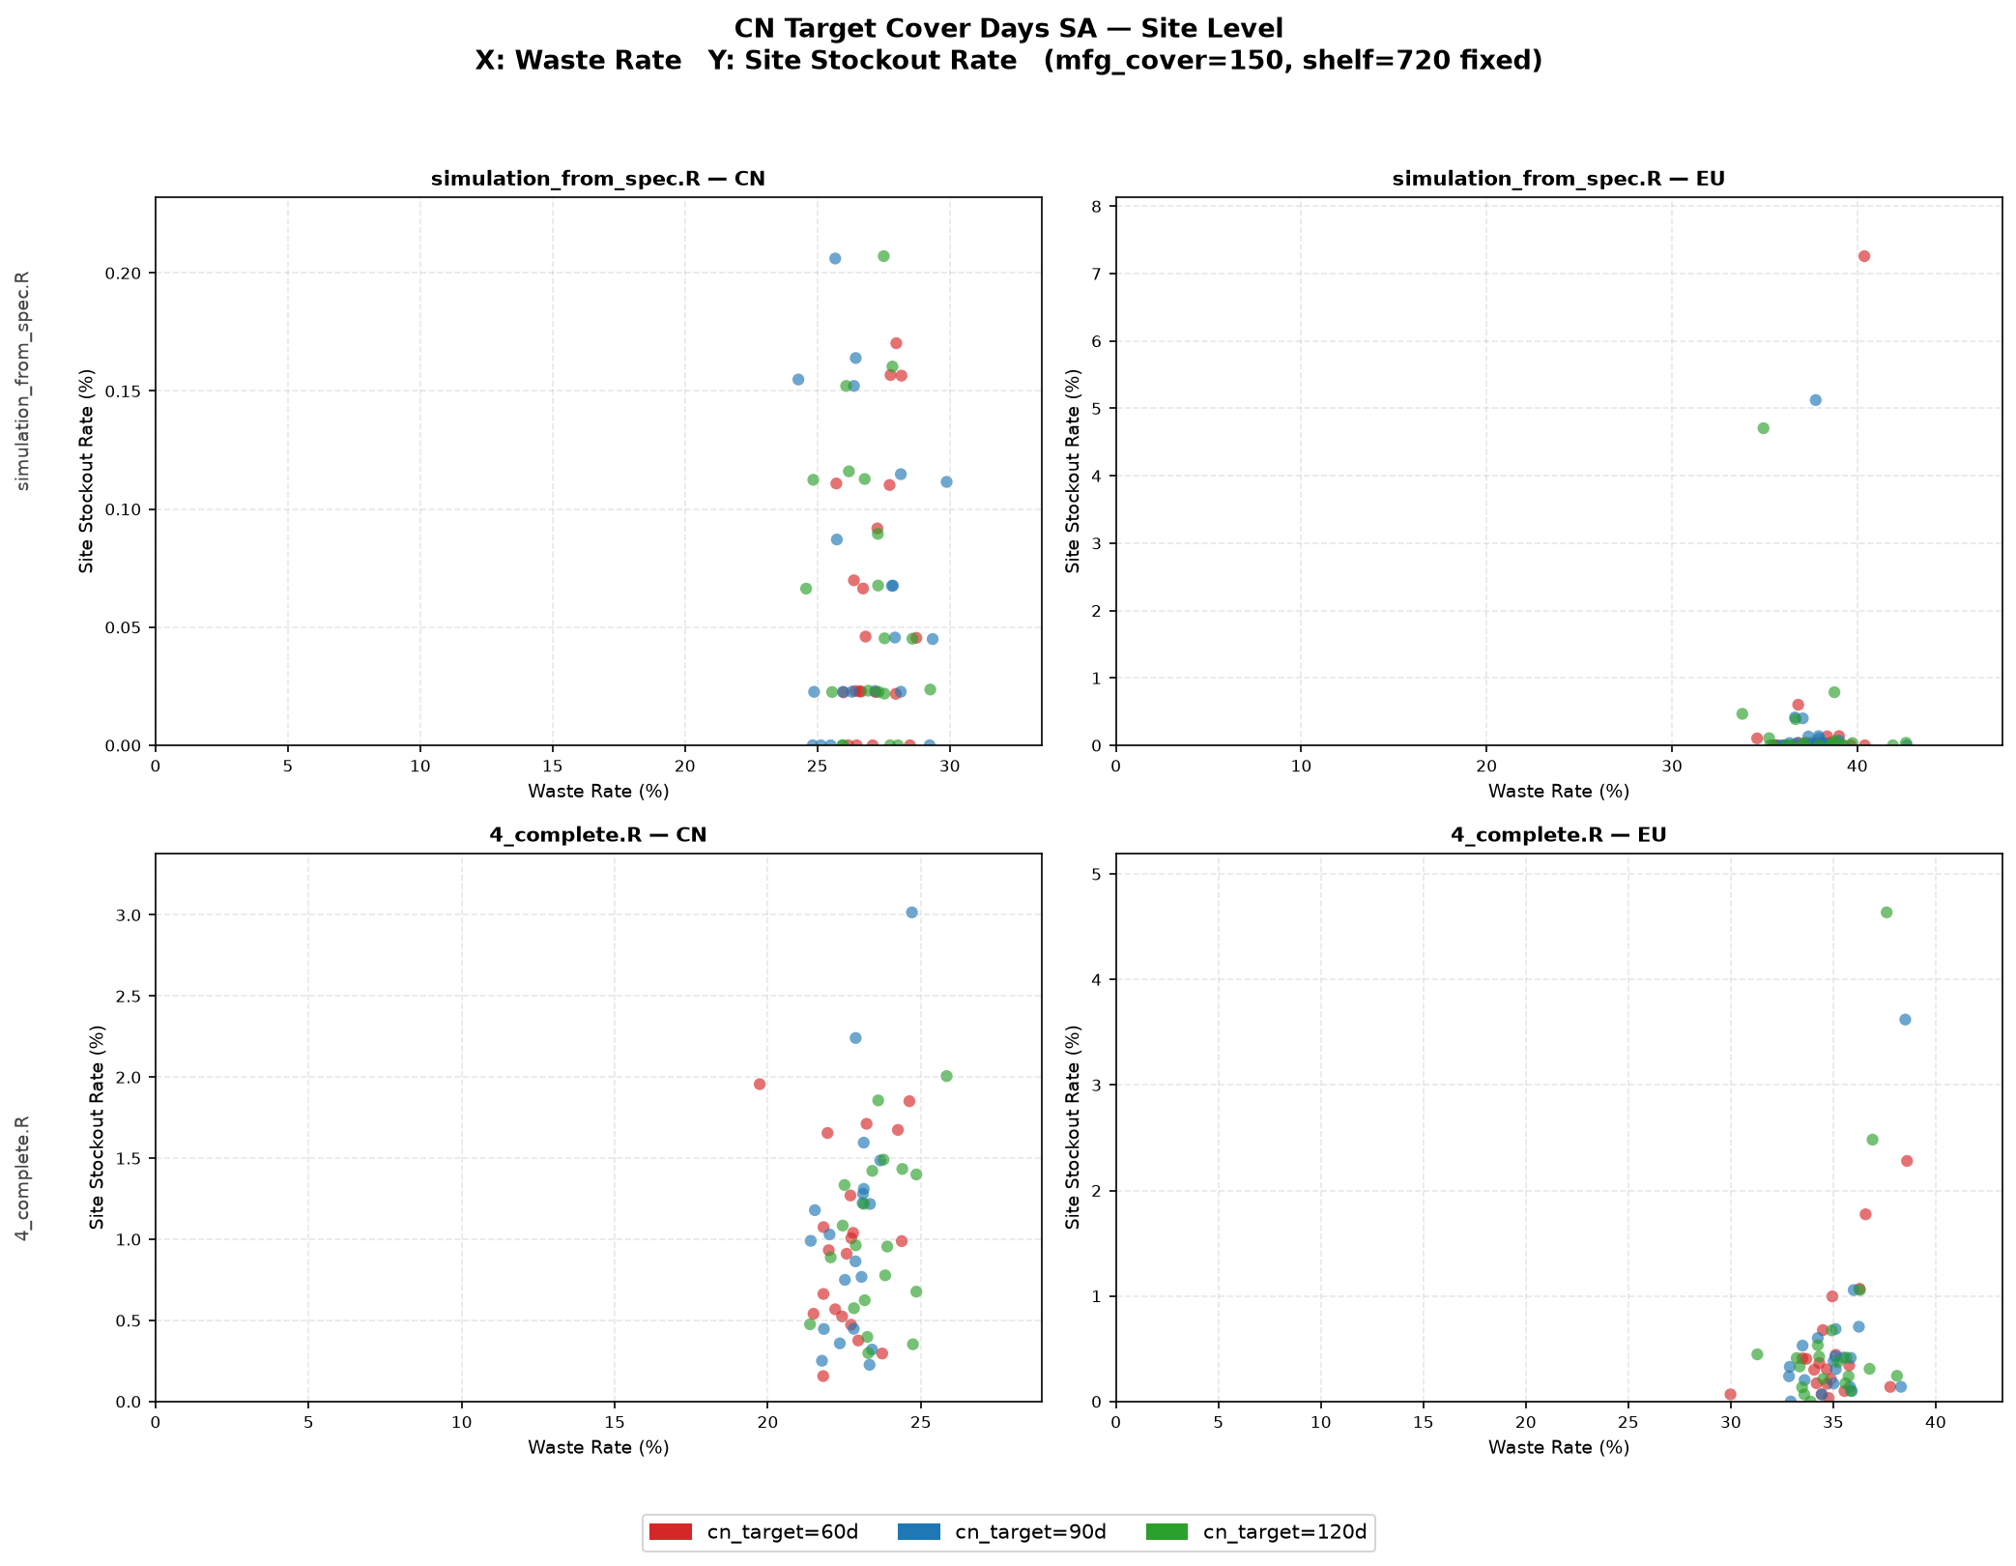
Cross model validation – cover (site level)
Shelf life =720
mfg_cycle_cover_days=150
CN Target Cover Days =60,90,120
No impacts
Cunyi Wang | J&J Supply Chain | Aug 2026

Slide 21
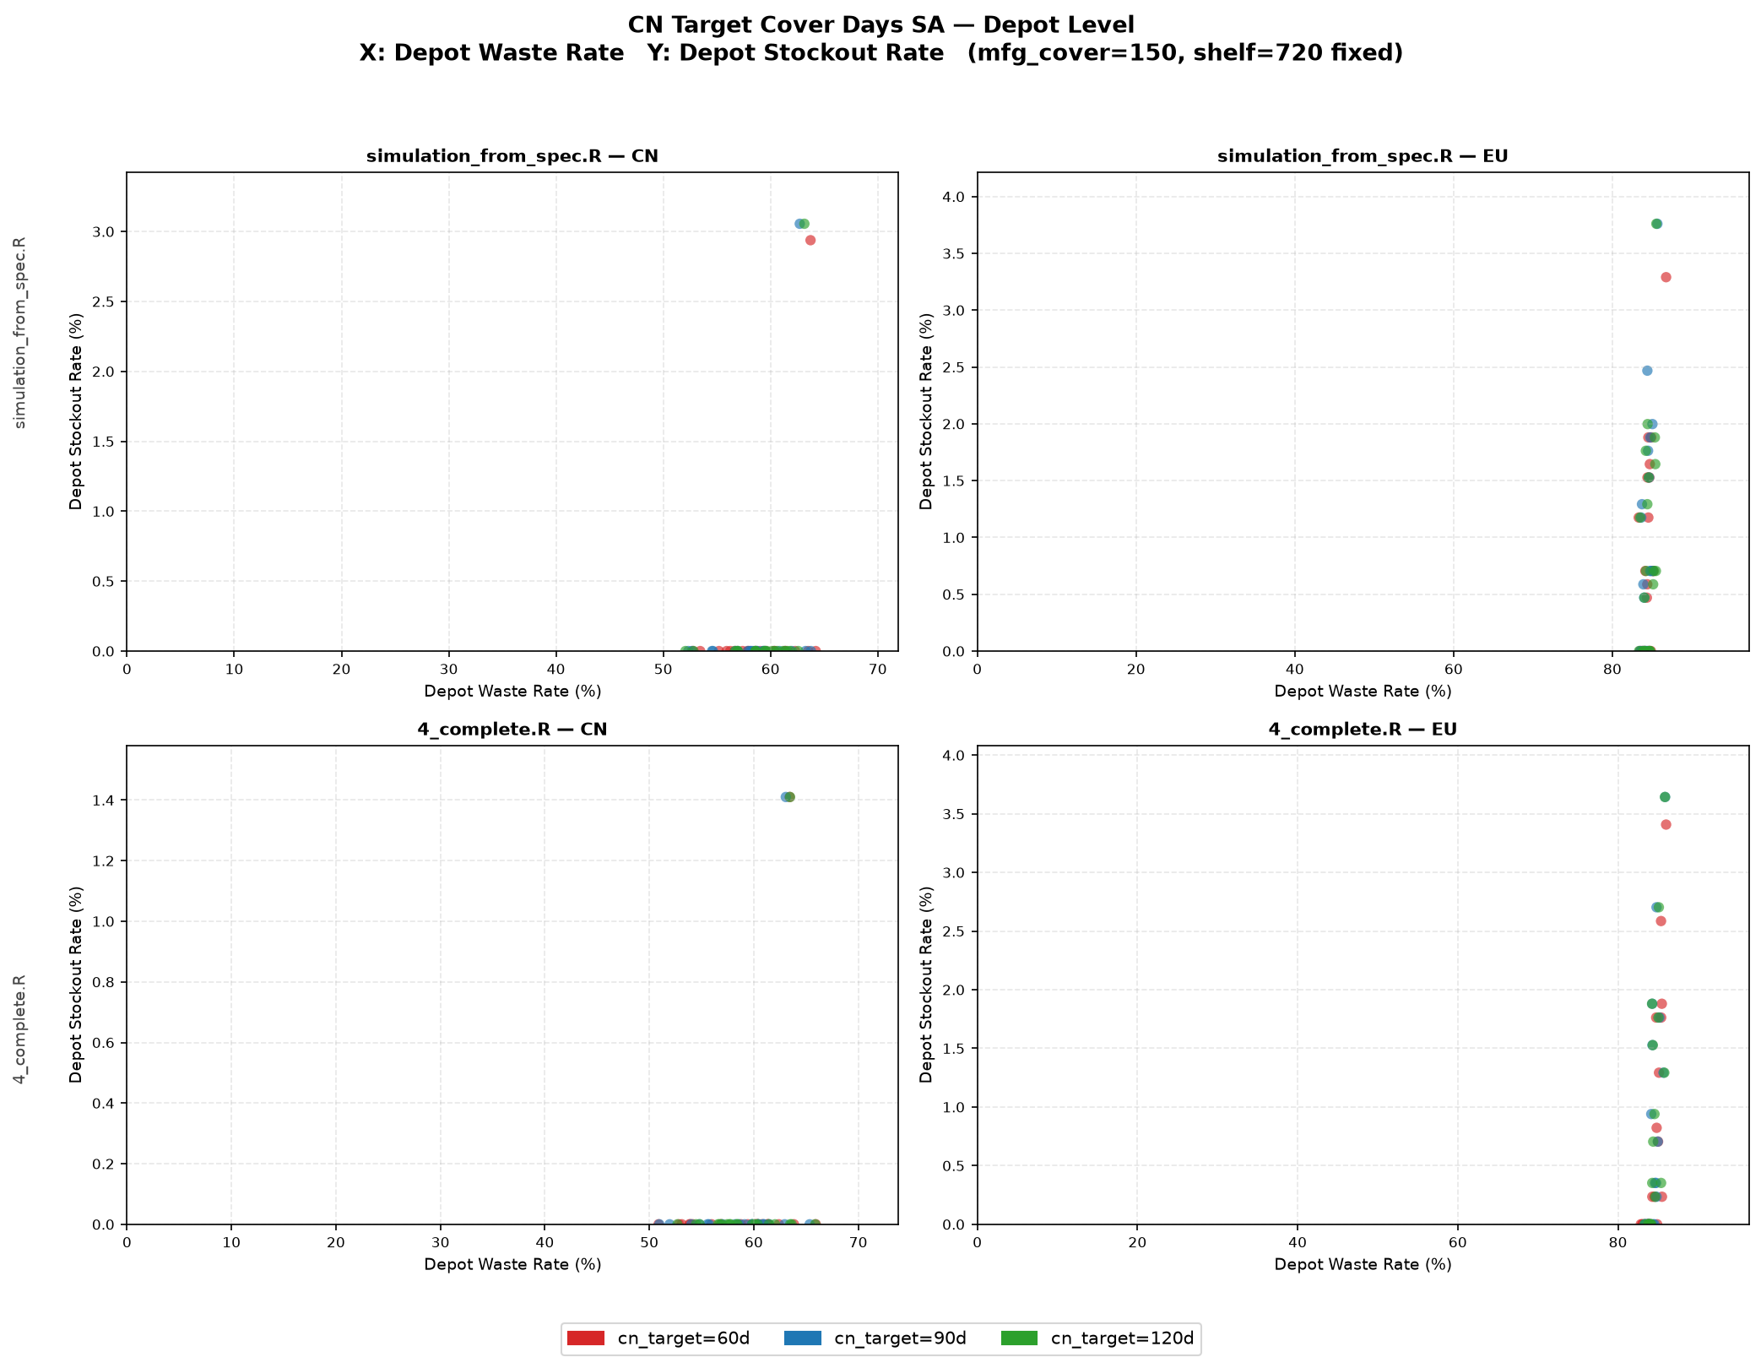
Cross model validation – cover (depot level)
Shelf life =720
mfg_cycle_cover_days=150
CN Target Cover Days =60,90,120
No impacts
Cunyi Wang | J&J Supply Chain | Aug 2026

Slide 22
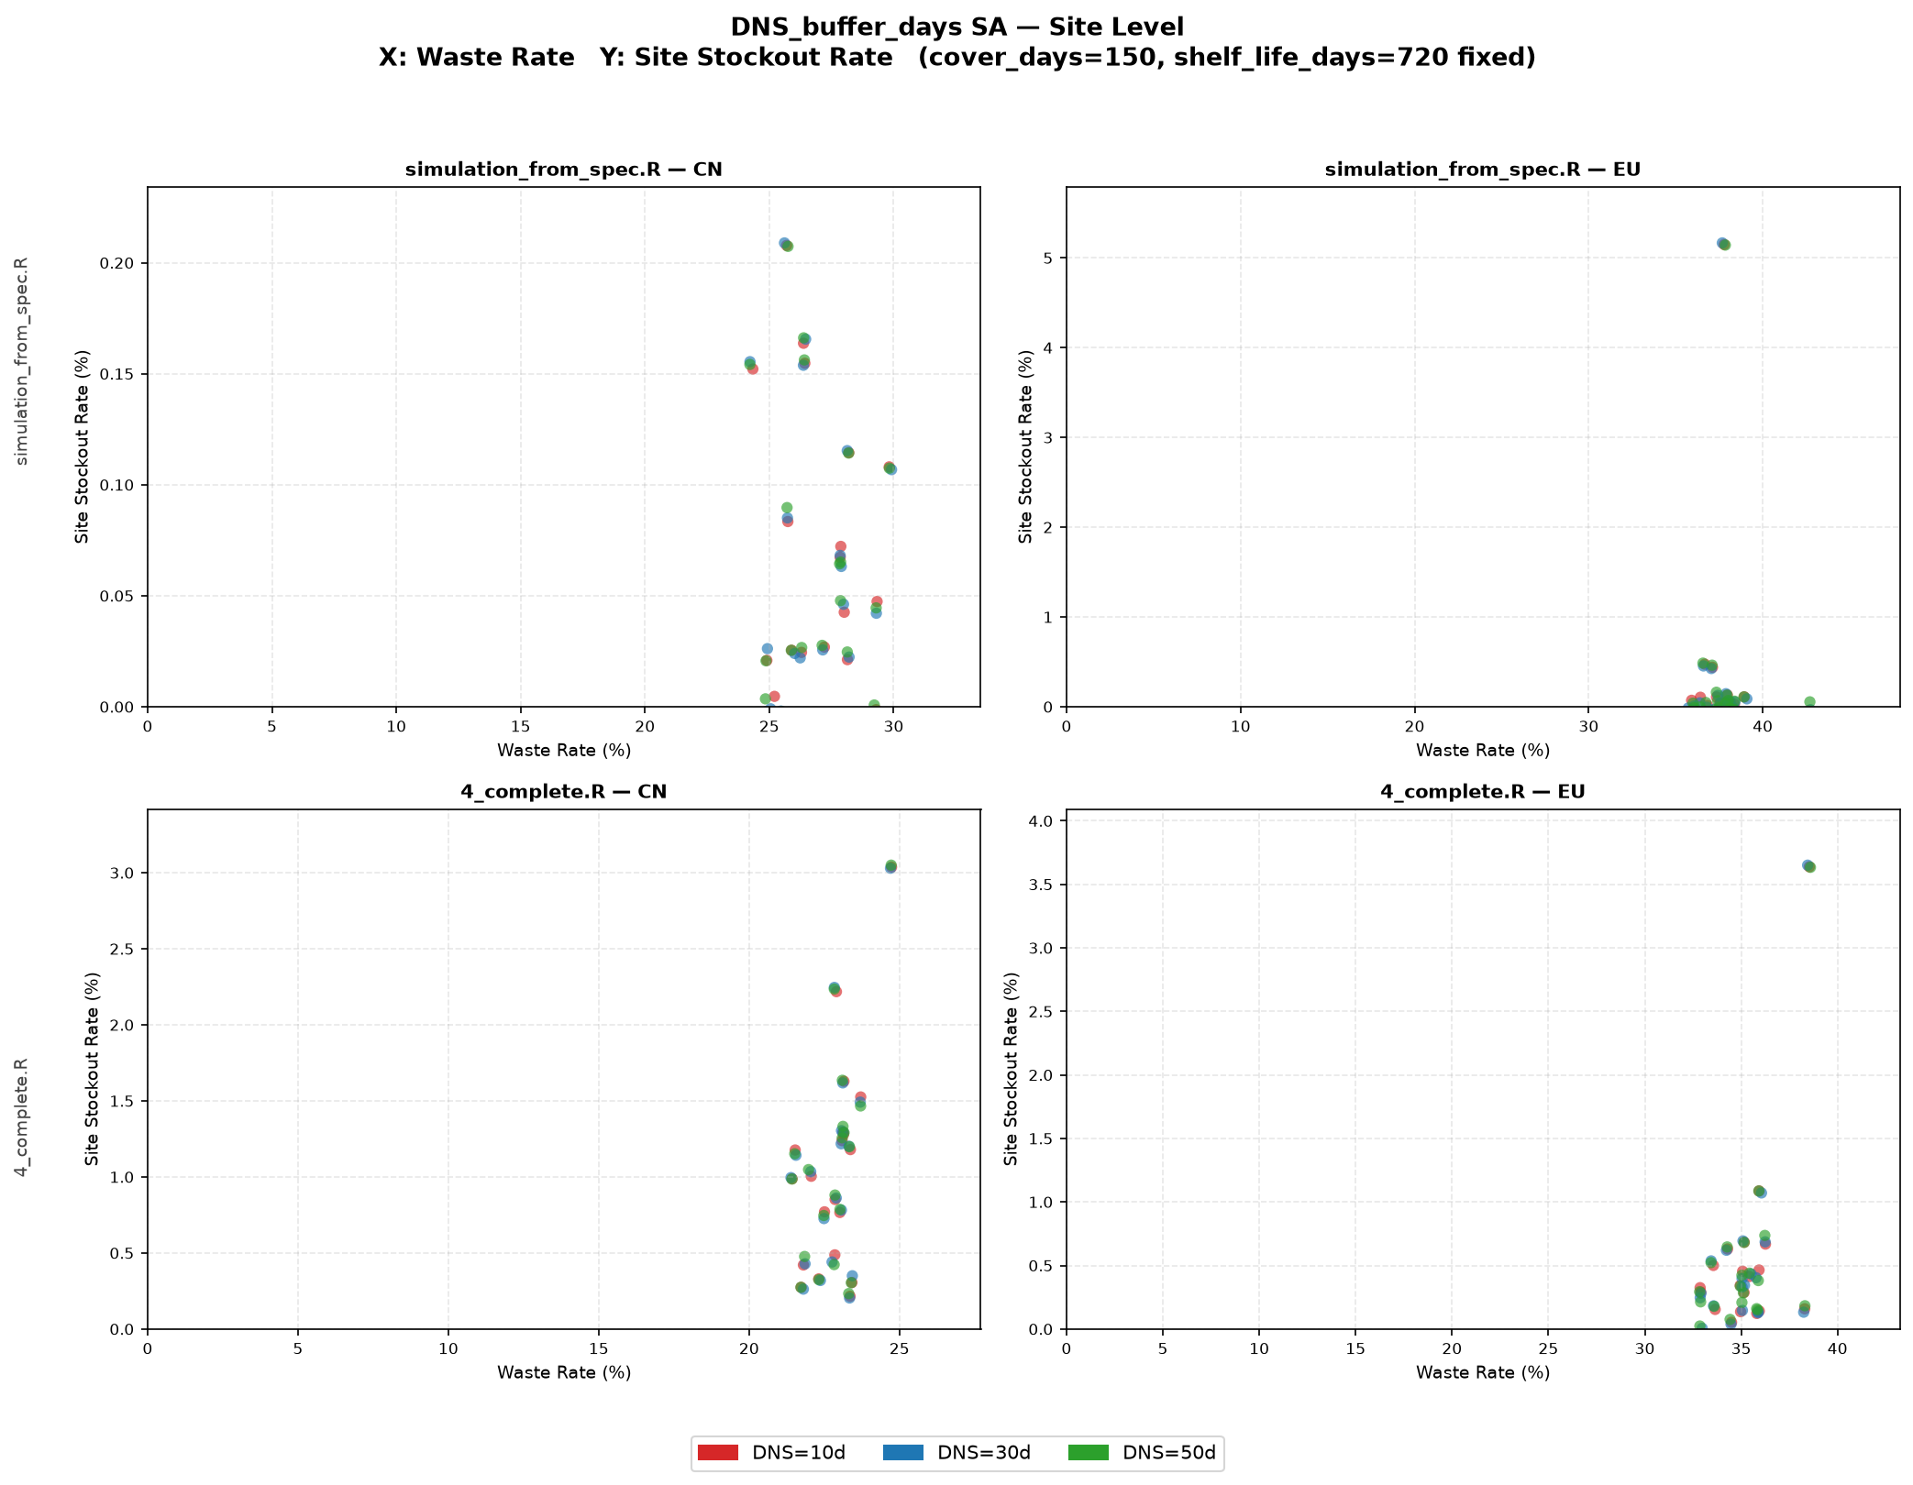
Cross model validation – cover (site level)
Shelf life =720
mfg_cycle_cover_days=150
CN Target Cover Days = 90
DNS=10,30,50
No impacts
Cunyi Wang | J&J Supply Chain | Aug 2026

Slide 23
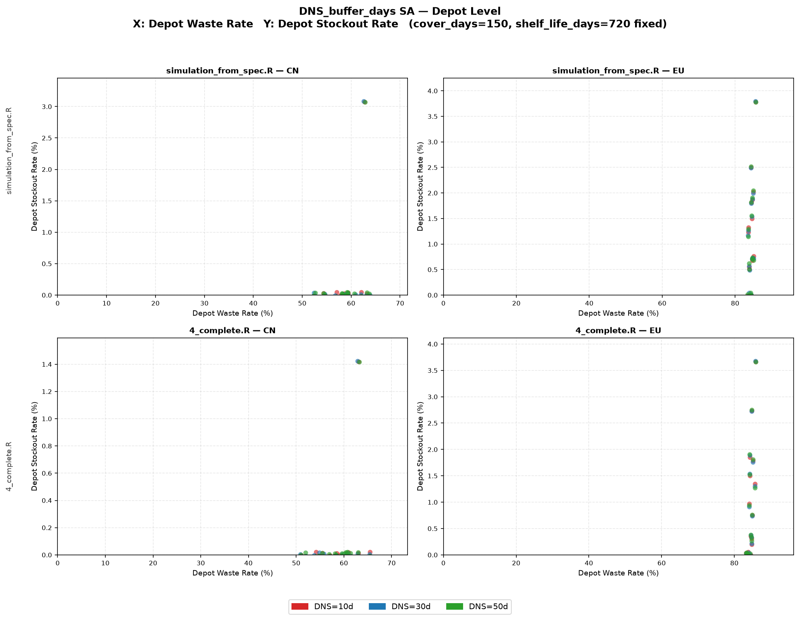
Cross model validation – cover (depot level)
Shelf life =720
mfg_cycle_cover_days=150
CN Target Cover Days =90
DNS=10,30,50
No impacts
Cunyi Wang | J&J Supply Chain | Aug 2026

